Slide 1
Wireshark Basics
Yongyong Wei

Slide 2
Outline
What is Wireshark
Objective
How it works
User Interfaces
Live Demo

Slide 3
What is Wireshark
Wireshark is a network packet/protocol analyzer.
A network packet analyzer will try to capture network packets and tries to display that packet data as detailed as possible.
Wireshark is perhaps one of the best open source packet analyzers available today for UNIX and Windows

Slide 4
Some intended purposes
network administrators use it to troubleshoot network problems
network security engineers use it to examine security problems
developers use it to debug protocol implementations
We use it to learn network protocol internals
Wireshark isn't an intrusion detection system.
Wireshark does not manipulate packets on the network, instead, it will only capture them passively from it.

Slide 5
How it works

Slide 6
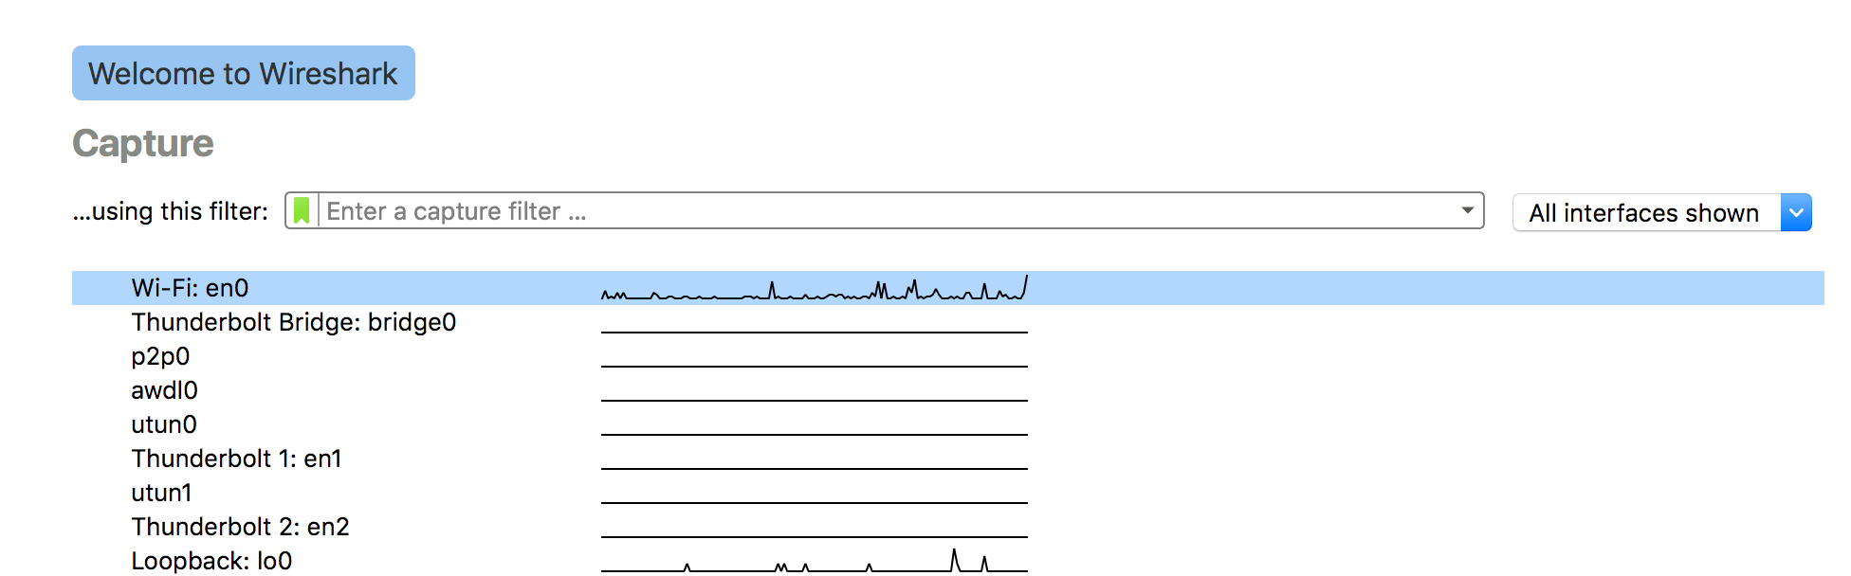
User Interfaces
Note you may need to install a plugin if prompted
Also needs root privilege.

Slide 7
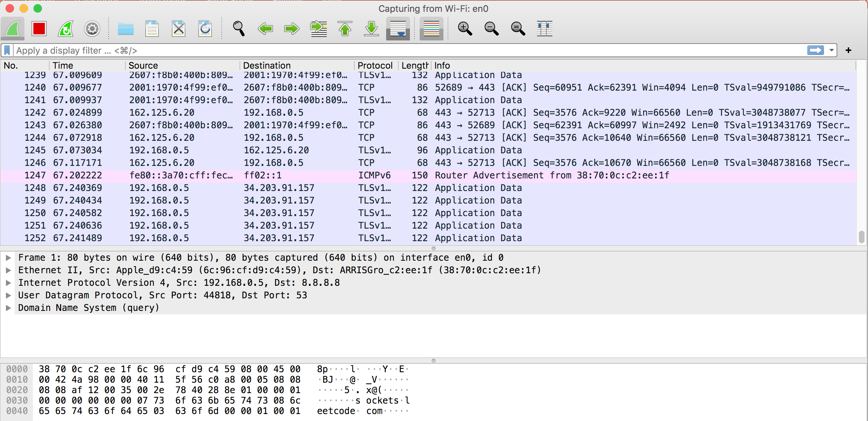
User Interfaces

Slide 8
Live Demo

Slide 9
Useful Tips
Select the correct network interface
Open another browser or clear the cache if nothing changed simply refresh the web page
Carefully use the filter for display
Not recommend simply type HTTP to observe the HTTP protocol.
Better to specify the target and source destination. E.g, ip.src == 130.113.68.10 || ip.dst == 130.113.68.10
Why?
Check out the manual: https://www.wireshark.org/docs/wsug_html_chunked/index.html

